Slide 1


Key Success Factors of Digital Transformation
Vision and Mission
Strategy
KRAs and KPIs
Process Workflow
Business Process Cycle
Instinctual Connect
Measurement
Change Management
Digital Technology
ICT
Moore’s Law
Internet
Data Communication
SMAC
IoT
Software
Tools
Digital Strategy and Process
Digital Mindset & Skills
Disruptive Innovation
Non-disruptive Innvn
Common techniques
Cross-Pollination
Intersection & Fusion
Dare-To-Try
Innovation in DX
Backbone & Empwrmt
Risk-takers
Data-Driven
Customer Obsessed
Tech-savvy
Business-savvy
Agile
Empowered
Adaptable
DIGITAL TRANS-FORMATION
Innovation –Business Models &
Technology
Business Technology Alignment
Cust Interaction stages
Customer Touchpoints
Data Collection
Fm Data to Insights
Fm Insights to Strategy
Customer Life Cycle
Customer centricity
Voice of Customer
Outcome driven
Shared Culture
Strategy alignment
Structure alignment
Process alignment
Drive for Innovation
Aligned Priorities
Tactical alignment
Customer Experience Management
Drive for DATA is embedded in each KSF
© Ashish Pachory

Slide 2

Lecture Series
Customer Experience Management
apachory@iitgoa.ac.in
Ashish Pachory

Slide 3
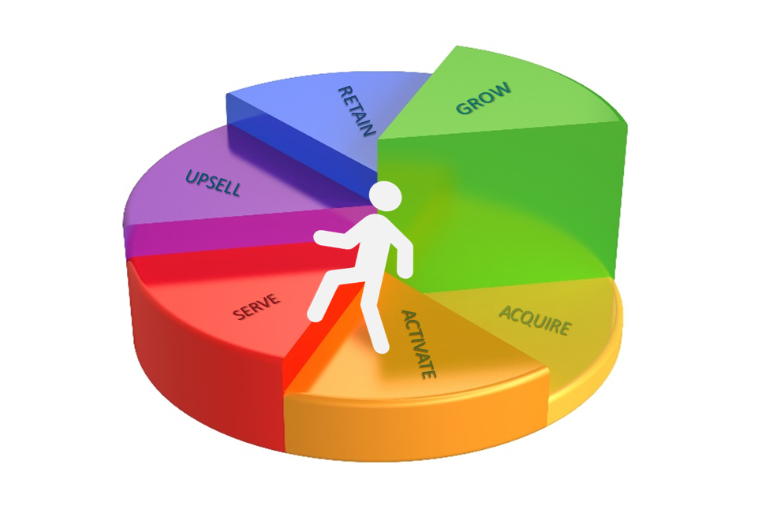
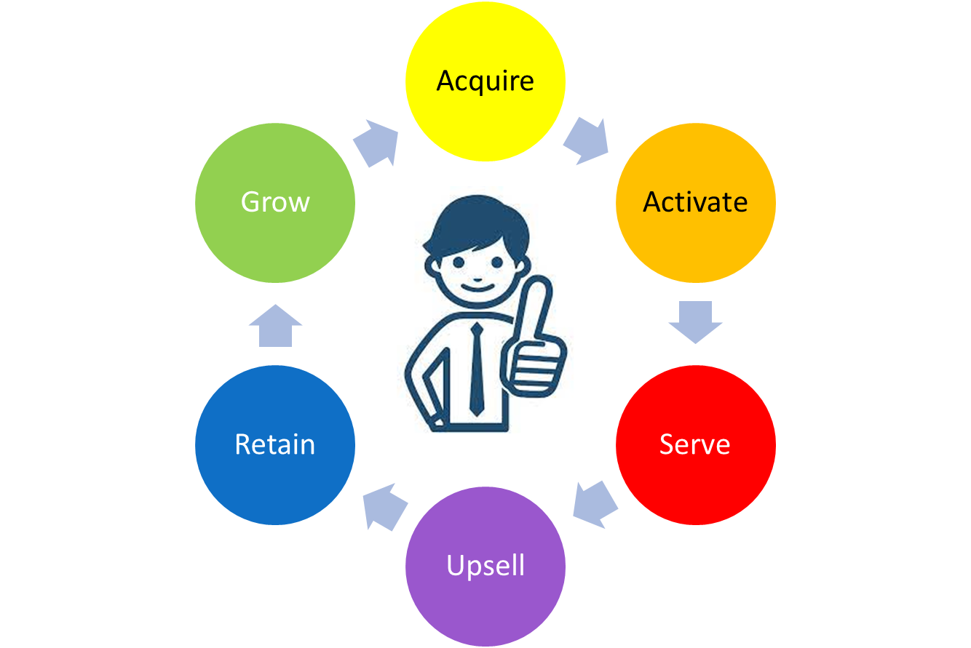
The Customer Lifecycle
Business Intelligence
Digital Marketing
Sales cycle (Leads to Closure)
Segmentation
Advocacy
Co-creation
Order Fulfilment
Monetization
Delivery Logistics
Churn Management
Loyalty programs
Customer Engagement
Call Center
Customer Relationship
Voice-of-Customer
Upgrades
Adjacencies
Renewals
© Ashish Pachory

Slide 4
Managing Individual CLC stages
1
What is the PURPOSE of this step?
2
What is the expected OUTCOME?
3
What is the GAP wrt Mkt/Customer expectations?
4
How can we BRIDGE this gap?
5
What are the TIME and COST considerations?
6
How are we going to MEASURE the outcome?
7
How can we IMPROVE the outcome?
© Ashish Pachory

Slide 5
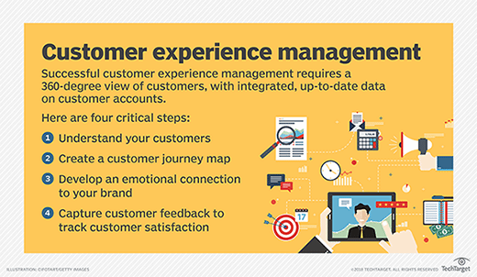
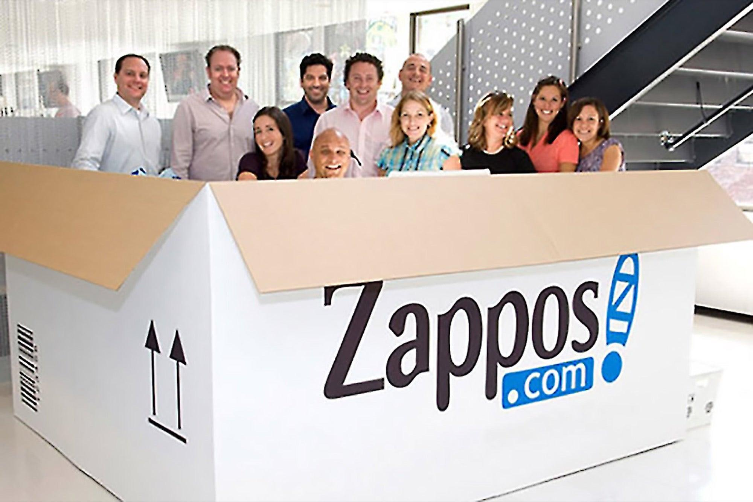
CX at work…
Example-1: Telecom
Example-2: Banking

Slide 6









CX Strategy for Digital Transformation
IMPROVED EXPERIENCE ACROSS LIFECYCLE
Product/ Service
Marketing
Customer Service
Point of Sale
Call Center
From INSIGHTS TO STRATEGY
CUSTOMER EXPERIENCE MANAGEMENT STRATEGY
Experience Data Repository
Structured
Unstructured
Social
Multimedia
Usage analysis
Segmentation
Preferences
Customized offers
From DATA to INSIGHTS
Web
Email
Chat
Data Probes
Phone
F2F
DATA COLLECTION CHANNELS
Press/Media
Social Media
Ads
Web sites
Telemarketing
Word of Mouth
Web sites
Product-Catalogue
Brochures
Email/Phone
References
Sales process
Demo
Company Store
Scope/Specs agreement
Quotes/ Proposals
Purchasing
Contract process
Invoicing
Order Ack’ment
Delivery Communication
Product Delivery
Installation
Customization
Service Activation
User Acceptance
Product/ Service Quality
Availability (Uptime)
Customer Training
Query handling
Accessibility to Service
Responsive-ness
Problem resolution –
Upgrades
Commn.
CUSTOMER TOUCH POINTS
CUSTOMER INTERACTION STAGES
Aware-ness
Discovery
Selection
Engage-ment
Delivery
Usage
Service
© Ashish Pachory

